Slide 1


Day 18
Math24 (Differential Equations)
Ch 3.3 Complex Roots of Characteristic Equation (Page 158-167)
Elementary Differential Equations and Boundary Value Problems, 10th edition, by William E. Boyce and Richard C. DiPrima, ©2013 by John Wiley & Sons, Inc.

Slide 2


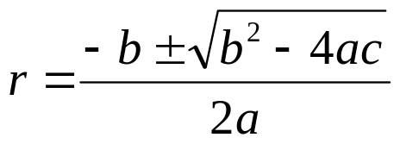

Recall our discussion of the equation
where a, b and c are constants.
Assuming an exponential soln leads to characteristic equation:
Quadratic formula (or factoring) yields two solutions, r₁ & r₂:
If b² – 4ac < 0, then complex roots: r₁ = λ + iμ, r₂ = λ - iμ
Thus

Slide 3
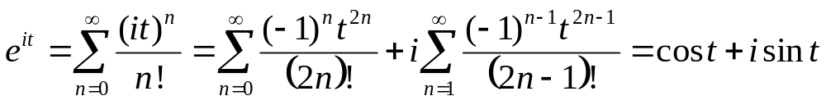

Euler’s Formula; Complex Valued Solutions
Substituting it into Taylor series for e^{t}, we obtain Euler’s formula:
Generalizing Euler’s formula, we obtain
Then
Therefore

Slide 4





Real Valued Solutions
Our two solutions thus far are complex-valued functions:
We would prefer to have real-valued solutions, since our differential equation has real coefficients.
To achieve this, recall that linear combinations of solutions are themselves solutions:
Ignoring constants, we obtain the two solutions

Slide 5

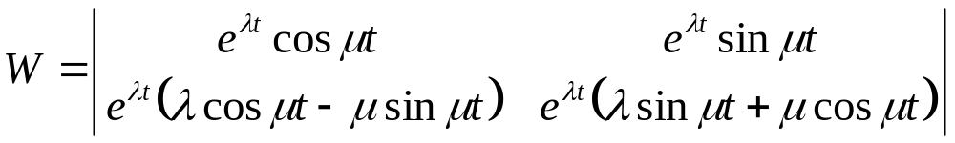


Real Valued Solutions: The Wronskian
Thus we have the following real-valued functions:
Checking the Wronskian, we obtain
Thus y₃ and y₄ form a fundamental solution set for our ODE, and the general solution can be expressed as

Slide 6

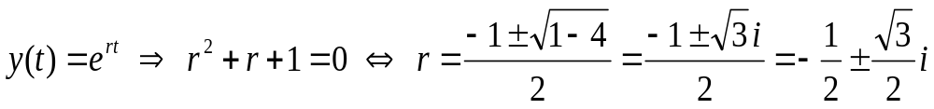

Example 1 (1 of 2)
Consider the differential equation
For an exponential solution, the characteristic equation is
Therefore, separating the real and imaginary components,
and thus the general solution is

Slide 7


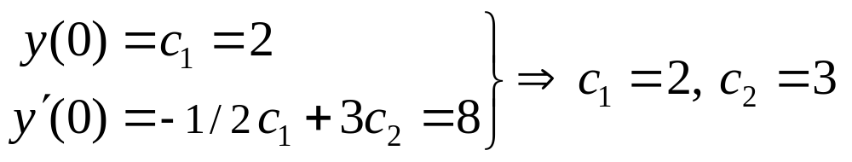
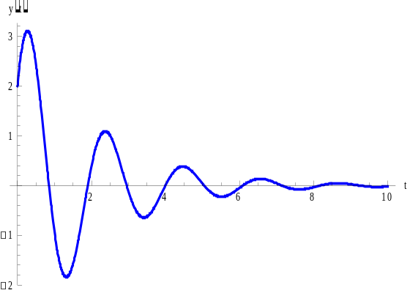


Example 1 (2 of 2)
Using the general solution just determined
We can determine the particular solution that satisfies the initial conditions
So
Thus the solution of this IVP is
The solution is a decaying oscillation

Slide 8
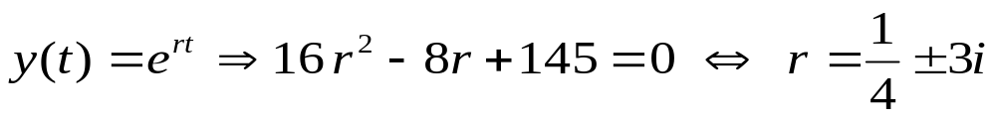

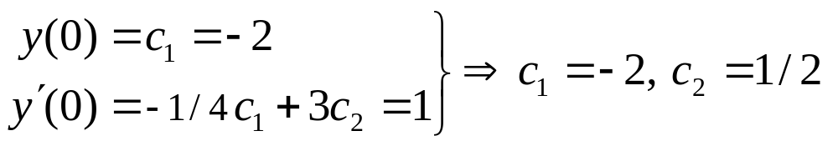
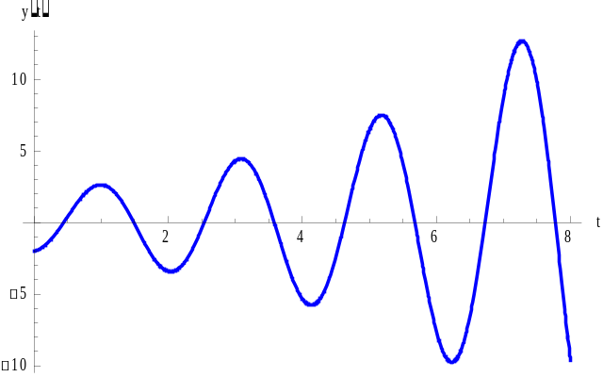

Example 2
Consider the initial value problem
Then
Thus the general solution is
And
The solution of the IVP is
The solution is displays a
growing oscillation

Slide 9





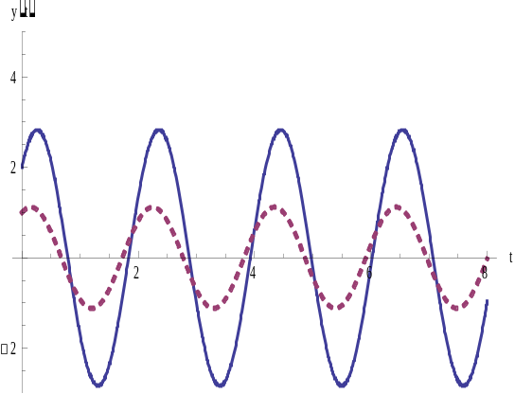

Example 3
Consider the equation
Then
Therefore
and thus the general solution is
Because there is no exponential
factor in the solution, so the amplitude
of each oscillation remains constant.
The figure shows the graph of two
typical solutions

